Slide 1
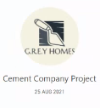
CELEBAL TECHNOLGIES PVT LTD.
POWER BI PROJECT
Submitted By :
Sophia
Muskaan

Slide 2
CONTENTS OF TABLE
Objective
Technology Used
What’s New ?
Target Audience
Project Demonstration
Future Score
Conclusion

Slide 3
OBJECTIVE :
The aim of the project is to create a report on the Cement Company Model using Business Intelligence Tool like Power Bi.

Slide 4
TECHNOLOGY USED :
This Project Uses Power Bi to Create Reports and make Business Driven Decisions.
Power Bi is a popular Business Intelligence Tool that pulls data together and processes it, turning it into intelligible insights, often using visually compelling and easy-to-process charts and graphs. This allows users to generate and share clear and useful snapshots of what’s happening in their business.
Power BI connects to a range of data sources, from basic Excel spreadsheets to databases, and both cloud-based and on-premise apps.

Slide 5
WHAT’S NEW ?
Today, Power BI provides us , the Users to create reports and interactive cloud-based visual dashboards without the help of an administrator or any information analyst. The service is available for both desktop and cell phones.
Power BI is not only just another cloud option to Microsoft Excel’s Pivot tables/charts or a mere data visualization function, but also as a user, we can slice data into various analytics. Microsoft over time has strived to bring many of their features of various programs under one superior data visualization platform.

Slide 6
TARGET AUDIENCE
The Tool is used by business intelligence professionals,who use it to create data models and reports to make Business Driven Decisions.
Power BI is often most popular with departments like finance, marketing, sales, human resources, it, and operations.

Slide 7
PROJECT DEMONSTRATION:
The project makes use of Power Bi to analyse and Visualize the Cement Company Model. The Analysis of this Model is done By Creating a Report that answers most of the Questions rose Based on the Dataset Provided and Visualizes them in an attractive Manner to derive business insights from the Report.
The Questions Answered By the Report are :

Slide 8
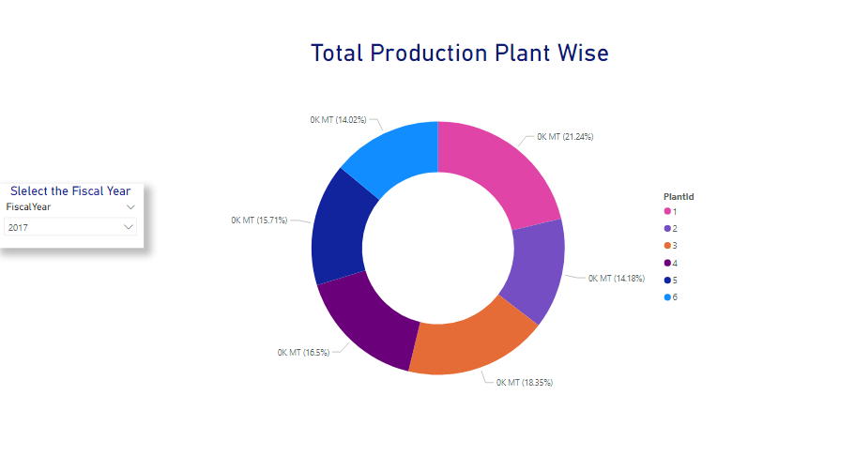
Analysis 1
The variation in production of cement plant wise and on the basis of the fiscal year.

Slide 9
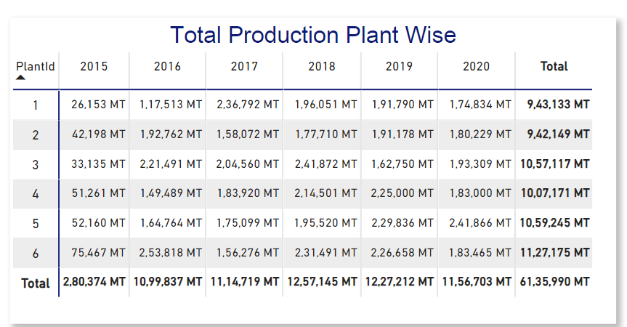

Slide 10
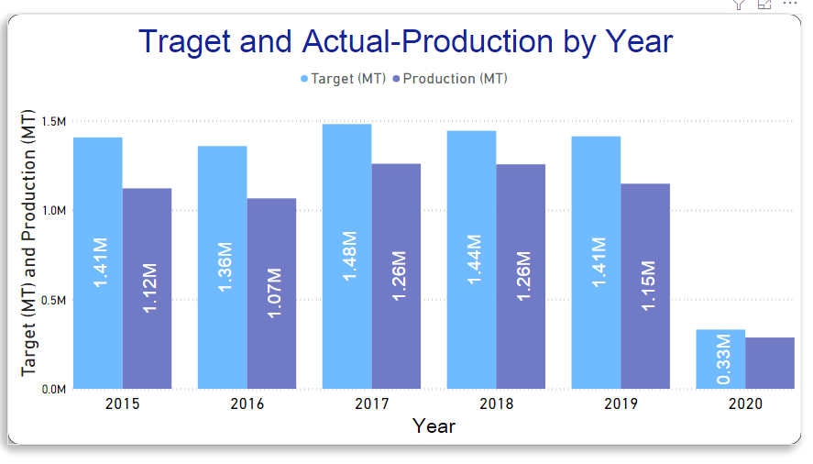
Analysis 2
The visuals Showing the Target and Target achieved in a particular year the manufacturing of cement.
Deliverabl 4

Slide 11
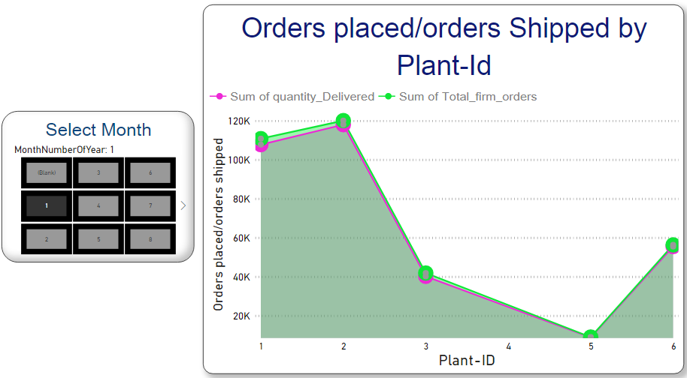
Analysis 3
The number of Delivery(shipped) and number of Orders Received Plant wise and Month-wise
Deliverabl 4

Slide 12
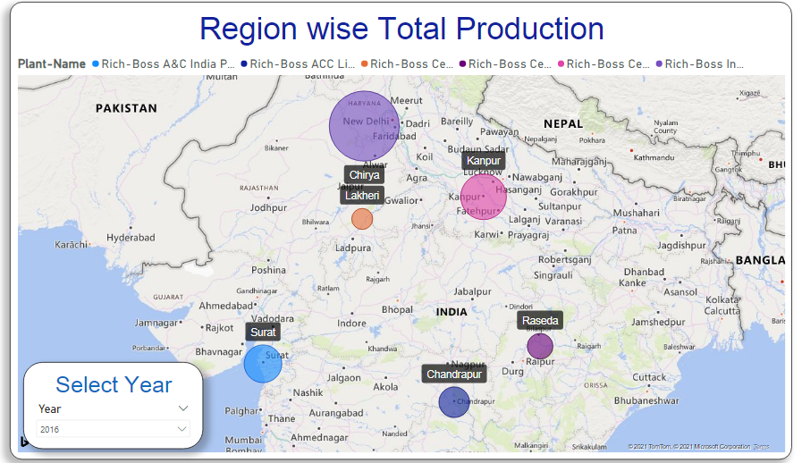
Analysis 4
Total Production region wise.
Deliverabl 4

Slide 13
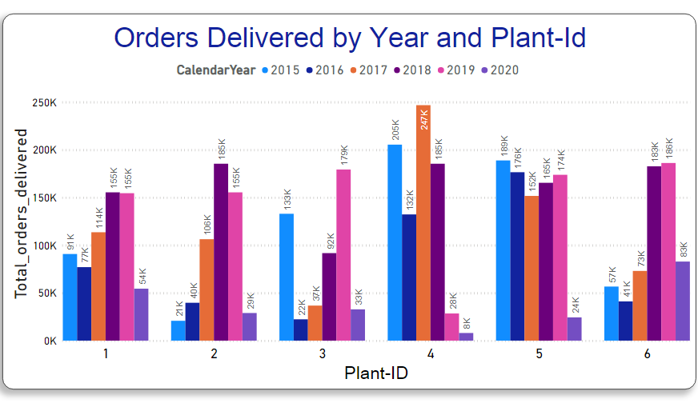
Analysis 5
Total Orders Delivered Plant Wise and Year Wise
Deliverabl 4

Slide 14
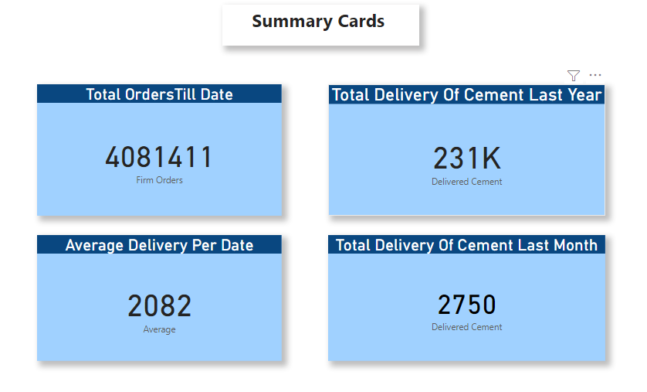
Analysis 6
Calculations Showing Qty sold till date, Avg Delivery Per Day, Total delivery of Cement last Year and last Month
Deliverabl 4

Slide 15
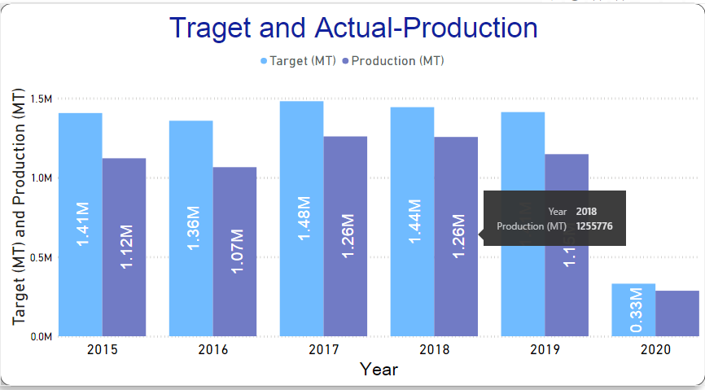
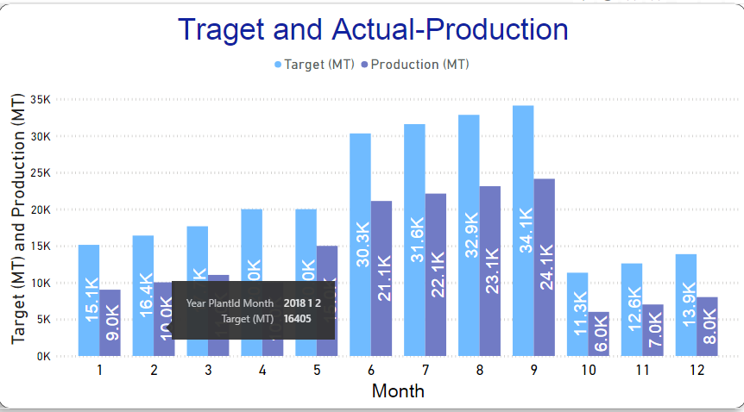
Analysis 6
Implementation Of Drill Down ( On Production Year wise to Plant Wise to Month Wise )
Deliverabl 4

Slide 16
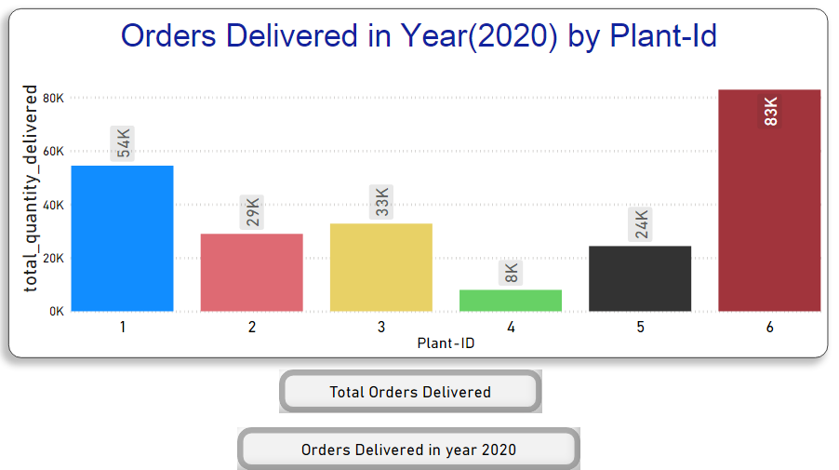
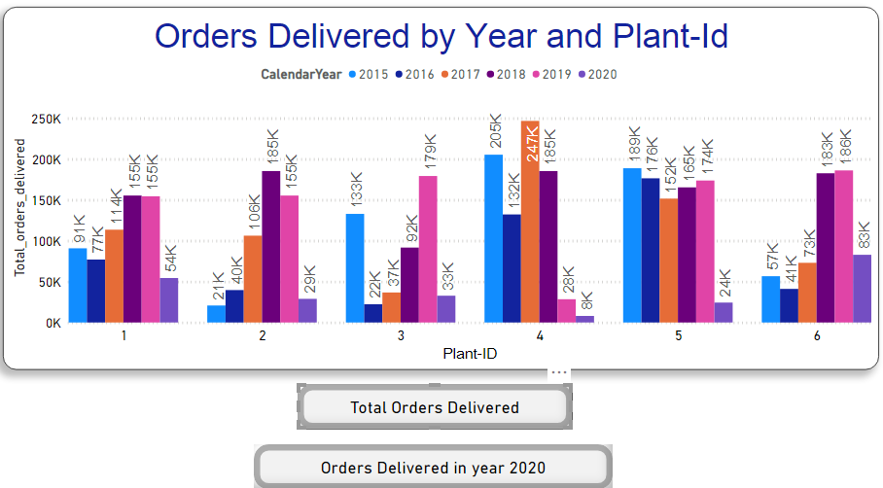
Analysis 7
Applying Bookmark on Orders Delivered in Year 2020
Deliverabl 4

Slide 17
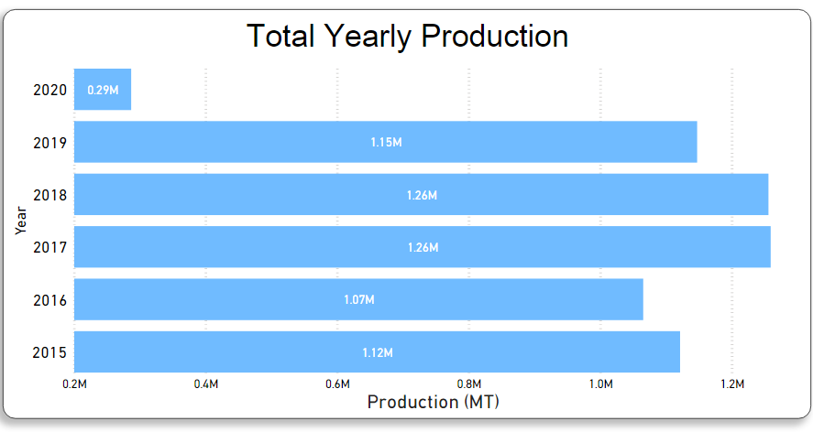
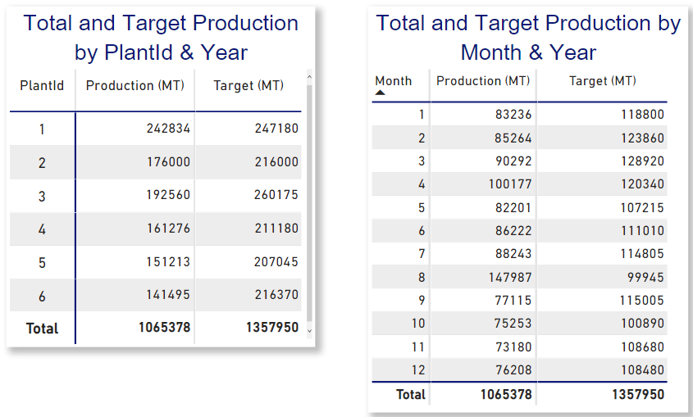
Analysis 7
Implementing Drill Through on Total Production
Deliverabl 4

Slide 18
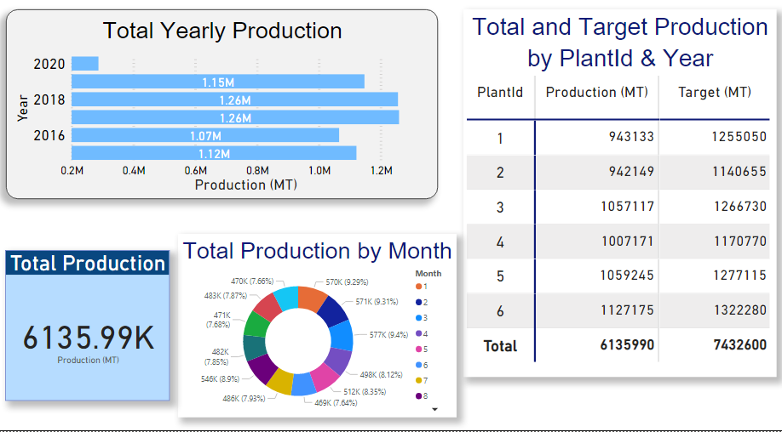
Analysis 8
Implementation of the Dynamic RLS
Deliverabl 4
Note : The page is visible only after the access is provided through email.

Slide 19
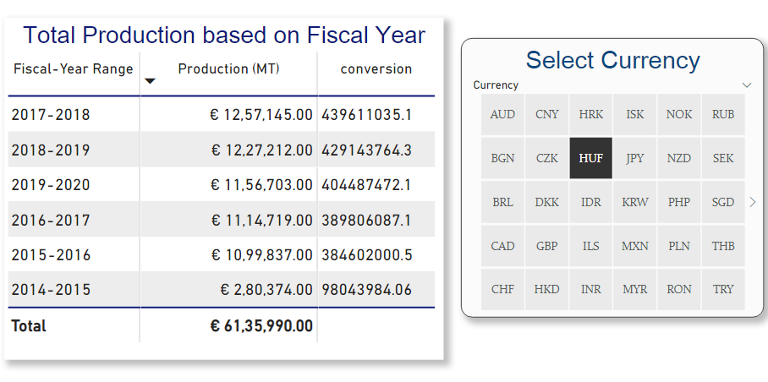
Analysis 9
Creating a Parameter Table for Denomination Conversion
Deliverabl 4

Slide 20
FUTURE SCOPE
The demand for BI (Business Intelligence) and Decision Making is increasing day by day. Power Bi is a dominant tool since years and being an easy to use tool for excellent data Visualization , will remain popular through years as well .
With a strong brand name of Microsoft behind it and many powerful features like easy integration to popular point solution and interactive visual dashboards, the growth of Power Bi in the Market is a Steep Slope.

Slide 21
CONCLUSION
This Project with the help of Data Visualization answers the Business Questions of the Cement Company Model, figuring variations in the sales, delivery of the cement for Certain Firms.
This Project also helps analyze the rise and fall in the number of orders of various firms over a period of time and the reasons for it.
In Conclusion, it summarizes the Cement Company Model in an effective way.
Click here to visit published app

Slide 22
THANKYOU

